Slide 1



Electric Reliability Risk Environment
Jim Robb, President and CEO,
North American Electric Reliability Corporation
Session 2b 22/September/2026

Slide 2
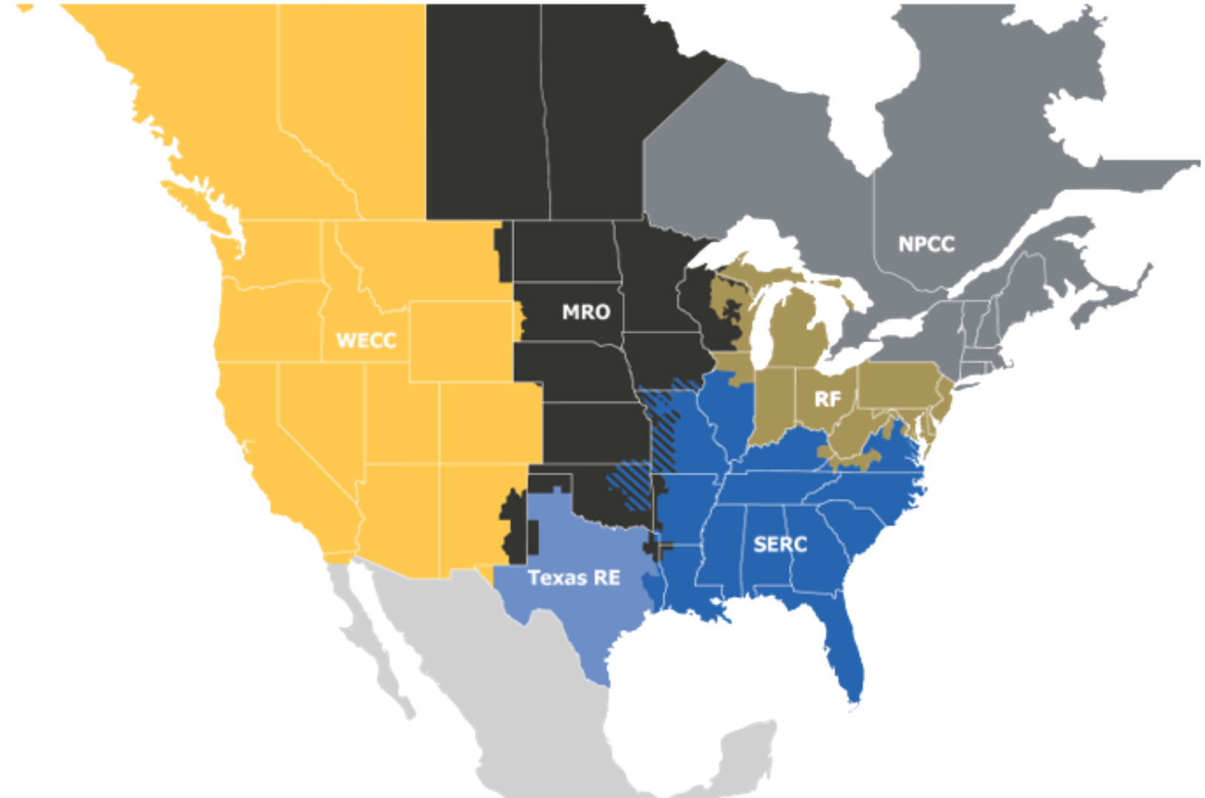
The ERO Enterprise
The vision for the Electric Reliability Organization (ERO), which is comprised of NERC and the six Regional Entities, is a highly reliable and secure North American bulk power system (BPS).
As the ERO, we are accountable to regulators in the United States (Federal Energy Regulatory Commission) and Canada (Canada Energy Regulator and provincial governments).

Slide 3
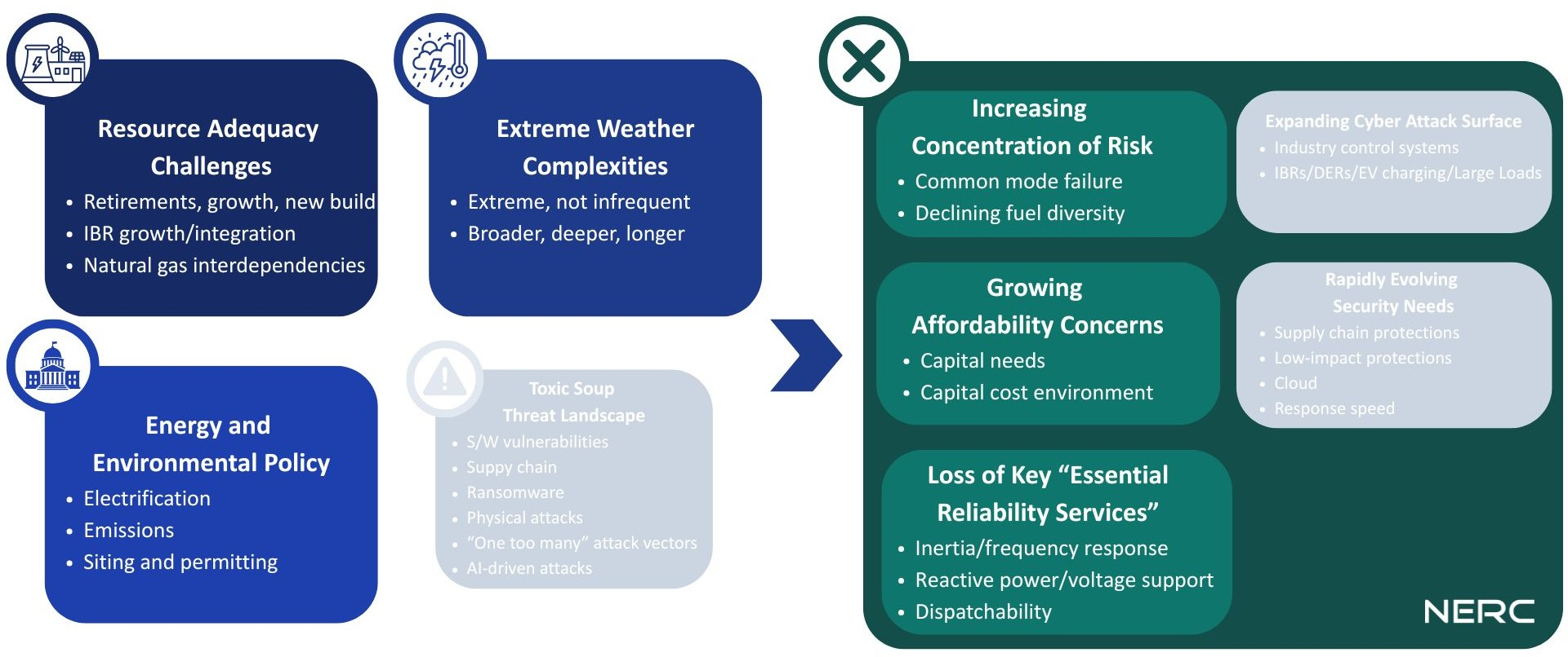
Hyper-Complex Risk Environment

Slide 4
Electric Reliability Risk Environment
Session 2b - Network reliability in a world of increasing climate change

